Slide 1
Introduction to philosophy Lecture 10
PHI1101
Dr. Lucas Scripter
Lecturer in General Education
School of Humanities and Social Sciences
Chinese University of Hong Kong, Shenzhen

Slide 2
review

Slide 3



Background: theories of truth
Correspondence Theory
A belief is true if and only if it corresponds or agrees to reality
Coherence
Theory
A belief is true if and only if it coheres with one’s other beliefs
Pragmatic
Theory
A belief is true if and only if it works.

Slide 4


Rejecting the ‘mirror or nature’
Justification as mirroring
the world
Justification as a
social practice

Slide 5


Two interpretations of ‘objectivity’
Objectivity as Correspondence
A belief is objectively true if it correctly maps on to reality or the way things are.
Objectivity as Agreement
A belief is objectively true if it is reached by a rationally informed consensus.
(See PMN, pp. 333ff)

Slide 6

Rorty’s ironism
Irony
Common-Sense

Slide 7



Rorty on human solidarity

Slide 8

Rorty’s public/private distinction

Slide 9
Challenging Philosophy’s self-image
Other Fields of Knowledge (Scientific, Moral, etc.)
Philosophical Theory of Knowledge/Mind

Slide 10


Two kinds of philosophy
Systematic Philosophy
Aims to provide a complete account.
Edifying Philosophy
Rejects ‘closure’ of knowledge; tries to change/revise/re-invent our vocabularies.
(See PMN, pp. 365ff)

Slide 11

Three ways of conceiving of philosophy
Philosophy as a Way of Life
Philosophy as the Foundation of the Sciences
Philosophy as Conceptual Analysis

Slide 12
Logical positivism

Slide 13
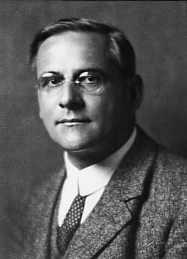
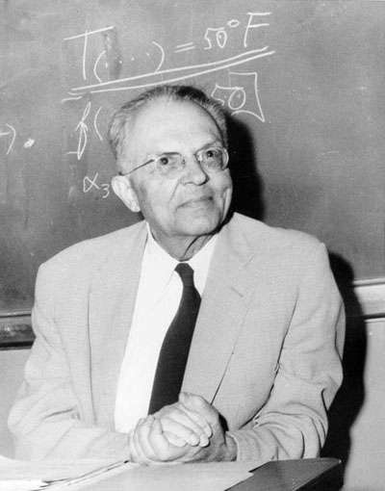
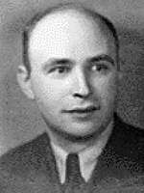
Major logical positivists
Moritz Schlick
(1882-1936)
Rudolf Carnap
(1981-1970)
Gustav Bergmann
(1906-1987)

Slide 14
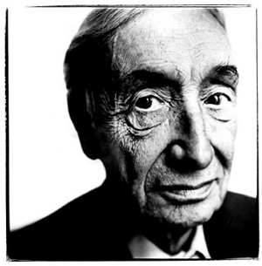
A.J. Ayer (1910-1989)
Graduate of Eton College and Oxford University
Visited the Vienna Circle
Major British exponent of logical positivism
Major Works:
Language, Truth, and Logic (1936)
The Problem of Knowledge (1956)

Slide 15
The verification principle

Slide 16

What makes an utterance meaningful?
“Colorless green ideas sleep furiously” (Chomsky)

Slide 17
The verification principle
The Verification Principle:
A statement is literally meaningful in only two cases:
It is an analytical statement, i.e., it is true by definition (tautology).
It is empirically verifiable through sense-experience.
The verification principle offered a criterion of meaningful sentences—it distinguished sensical utterances from non-sense.
Ayer used the verification principle to argue that common philosophical sentences were actually disguised nonsense:
“we shall maintain that no statement which refers to a ‘reality’ transcending the limits of all possible sense-experience can possibly have any literal significance; from which it must follow that the labours of those who have striven to describe such a reality have all been devoted to the production of nonsense.” (LTL, p. 34)

Slide 18
What does ‘verification’ mean?
Practical Verifiability
Propositions of fact that we have the ability to verify in practice.
Verifiability in Principle
Propositions of fact that we know what could count as verification, even if we lack the ability to verify them in practice, e.g., technological limitation.
Example: CUHKSZ has 4,567 undergraduate students.
Example: There is a planet containing water in the galaxy GN-z11.

Slide 19
Two kinds of verification principle
Strong Verification Principle
Verification requires conclusive demonstration.
Weak Verification Principle
Verification requires that a proposition is probable.
Problem: this would make general statements or laws non-sense: “all humans are mortal.”
Ayer adopts this version.

Slide 20
Analytic & synthetic judgments
Analytic
The subject X contains the predicate Z.
Example: “A bachelor is an unmarried, adult male.”
Synthetic
The subject X does not contain the predicate Z; the predicate Z adds something to the subject Z.
Example: “Dr. Christopher Kluz is a bachelor.”
“All bodies are extended”
“This table is metallic”

Slide 21
A priori & a posteriori judgments
A Priori
A priori judgments are not justified by appeal to experience.
Certain & Necessary
A Posteriori
A posteriori judgments are justified by appeal to experience.
Uncertain & Contingent

Slide 22
Kant & Russell Types of Propositions
A Posteriori Synthetic
Empirical Propositions
X
A Priory Synthetic
Ethical Propositions/Mathematical & Logical Propositions
A Priori Analytic
Tautologies
Propositions

Slide 23
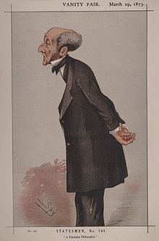
Option 1: Mill’s strategy
J.S. Mill’s treatment of logical and mathematical propositions held them to be “inductive generalizations based on an extremely large number of instances.” (LTL, p. 74)
“Experience gave us very good reason to suppose that a ‘truth’ of mathematics or logic was true universally; but we were not possessed of a guarantee. For these ‘truths’ were only empirical hypotheses which had worked particularly well in the past; and, like all empirical hypotheses, they were theoretically fallible.” (LTL, p. 74)

Slide 24
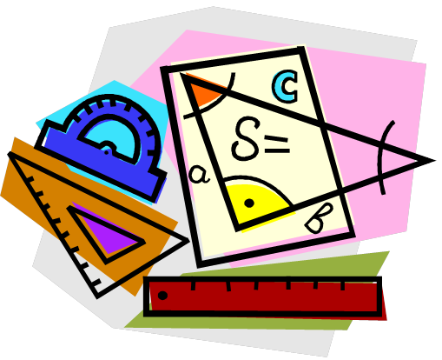
Objection to mill’s strategy
Ayer claims that Mill is wrong that mathematical and logical propositions are highly probable generalizations know through induction.
Considerations of how we would refute mathematical or logical propositions reveals that we don’t treat them like inductive generalizations:
“Whatever the instance we care to take, we shall always find that the situations in which a logical or mathematical principle might appear to be confuted are accounted for in such a way as to leave the principle unassailed. And this indicates that Mill was wrong in supposing that a situation could arise which would overthrow a mathematical truth. The principles of logic and mathematics are true universally simply because we never allow them to be anything else.” (LTL, p. 77, italics mine)

Slide 25
Option 2: ayer’s strategy
A.J. Ayer claims that all analytic propositions are a priori—they are true by definition.
He argues that Kant confuses a psychological criterion and a logical criterion for distinguishing analytic judgments.
Analytic judgments reveal the logical relationships between our linguistic symbols.
“the power of logic and mathematics to surprise us depends, like their usefulness, on the limitations of our reason. A being whose intellect was infinitely powerful would take no interest in logic and mathematics. For he would be able to see at a glance everything that his definitions implied, and, accordingly, could never learn anything from logical inference which he was not fully conscious of already. But our intellects are not of this order. It is only a minute proportion of the consequences of our definitions that we are able to detect at a glance.” (LTL, p. 86)

Slide 26
Ayer on Types of Propositions
Propositions
A Priori Analytic
Tautologies
X
X
A Posteriori Synthetic
Empirical Propositions

Slide 27
Implications of the verification principle

Slide 28
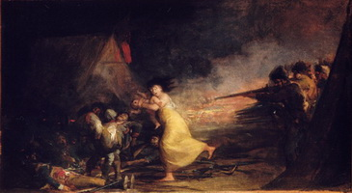
Metaphysics is non-sense
Using the verification principle, Ayer argues that traditional metaphysical problems are literally non-sensical because they involve neither (a) tautologies nor (b) empirically verifiable propositions.
Example:
“the Absolute enters into, but is itself incapable of, evolution and progress.” (from Bradley’s Appearance and Reality quoted in LTL, p. 36)
Debate between realists and idealists.
Compare with the proposition, “this painting by Goya isn’t real.”

Slide 29
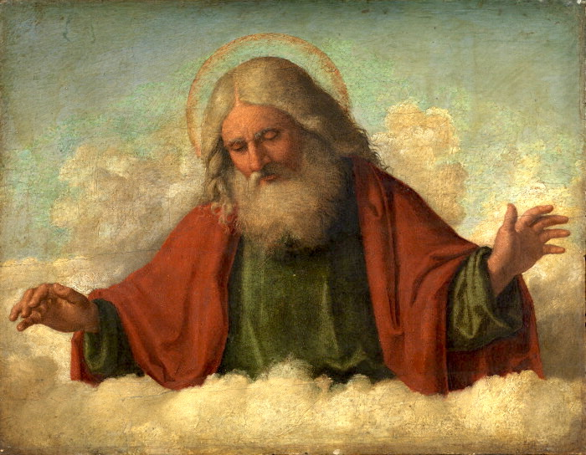
Critique of theology
Ayer argues that his verification principle also shows theological discourse to be literally meaningless because it is neither true by definition nor empirically verifiable.
“if ‘god’ is a metaphysical term, then it cannot be even probable that a god exists. For to say that ‘God exists’ is to make a metaphysical utterance which cannot be either true or false.” (LTL, p. 115)

Slide 30

Emotivist theory 1
Ayer’s verification principle holds that ethical propositions do not count as literally meaningful. He calls them “pseudo-propositions.”
The function of ethical language is to express approval or disapproval; it doesn’t add anything literally meaningful to a sentence.
Example:
“You acted wrongly in stealing my wallet!”
=
“You stole my wallet” and “boo! I don’t like that”
Boo!

Slide 31

Emotivist theory 2
Ayer argues that moral disagreement faces limits: we can argue about facts but not values.
Many ethical disputes are actually “a question of fact. When someone disagrees with us about the moral value of a certain action or type of action…What we attempt to show is that he is mistaken about the facts of the case. We argue that he has misconceived the agent’s motive: or that he has misguided the effects of the action…But if our opponent happens to have undergone a different process of moral ‘conditioning’ from ourselves…then we abandon the attempt to convince him by argument…we find that argument is possible on moral questions only if some system of values is presupposed.” (LTL, p. 111)

Slide 32

Emotivist theory 3
Ayer argues that the emotivist theory also applies to aesthetics:
“Such aesthetic words as ‘beautiful’ and ‘hideous’ are employed, as ethical words are employed, not to make statements of fact, but simply to express certain feelings and evoke a response.” (LTL, p. 113)
“The critic, by calling attention to certain features of the work under review, and expressing his own feelings about them, endeavors to make us share his attitude towards the work as a whole. The only relevant propositions that he formulates are propositions describing the nature of the work. And these are plain records of fact.” (LTL, pp. 113-4)

Slide 33
What’s left for philosophy?

Slide 34
Philosophy as logical analysis 1
Ayer argues that philosophy’s job is to perform linguistic analysis to help us clarify our concepts:
“For the philosopher, as an analyst, is not directly concerned with the physical properties of things. He is concerned only with the way in which we speak about them.” (LTL, p. 57)
“the propositions of philosophy are not factual, but linguistic in character—that is, they do not describe the behavior of physical, or even mental, objects; they express definitions, or the formal consequences of definitions. Accordingly, we may say that philosophy is a department of logic.” (LTL, p. 57)
“it is important that no one should be deceived…into supposing that the philosopher is engaged on an empirical or metaphysical enquiry. We may speak loosely of him as analyzing the facts, or notions, or even things. But we must make it clear that these are simply ways of saying that he is concerned with the definition of the corresponding words.” (LTL, p. 59)

Slide 35

Philosophy as logical analysis 2
Ayer thinks that philosophy’s job does not involve making empirical claims or observations—that’s the role of the sciences.
Philosophy can still help to clarify our language.
Example: “a material thing cannot be in two places at once. This looks like an empirical proposition, and is constantly invoked by those who desire to prove that it is possible for an empirical proposition to be certain at all. But a more critical inspection shows that it is not empirical at all, but linguistic. It simply records the fact that, as a result of certain verbal conventions, the propositions that two sense-contents occur in the same visual or tactual sense-field is incompatible with the proposition that they belong to the same material thing.” (LTL, p. 58)

Slide 36
bibliography
Ayer, A.J. ((1952/1936), Language, Truth, and Logic. Dover.

